Slide 1
DATA STRUCTURES AND ITS APPLICATIONS (UE22CS252A)
Mini Project

Slide 2
Project Title & Team Members
TITLE: METRO ROUTE TRACKER
TEAM MEMBERS :
1. Durgadeepa P PES2UG22CS189
2. G Spandana PES2UG22CS195
3. Gagana Sindhu P PES2UG22CS198
4. Gauthami S PES2UG22CS201
GAGANA SINDHU P : PES2UG22CS198
GAUTHAMI S : PES2UG22CS201
G SPANDANA : PES2UG22CS

Slide 3
DATA STRUCTURES USED : like e distance between stations. This
1.Graphs(adjacency list): Graphs are commonly used to represent the stations where each station is a node and the connections between stations are edges.
2.Linked Lists : Linked lists are used to represent the adjacency list data structure and represent the connections between metro stations, allowing for easy traversal of metro network and finding the fartest station from given source station.
3.Arrays : Arrays help us to track visited nodes, distance from source , and manage the nodes to be explored.it explores the graph to find the farthest node from source. o manage the stations on a specific metro line and their connectivity.
4. Array: For defining the station names.

Slide 4
FUNCTIONALITIES
Route Planning : Helping passengers plan their journeys by providing route options, information on transfers, estimated travel times, and fare details.
Fare Calculations: Calculating and displaying the cost of a journey based on the selected routes and fare zones.
Data Analytics: Collecting data on passenger usage and preferences to improve services and plan future developments.
Safety Measurements: Providing safety information and emergency contact details for passengers' well-being.
User Interface: It receives information of the user where users can input their starting and ending stations and provide the best route and fare information.
Ticket Information: It includes details whether there are seats available in the compartment and it also asks and verifies the number of seats required for the passenger and also shows the tickets sales report which includes number of tickets sold and from start to destination.

Slide 5
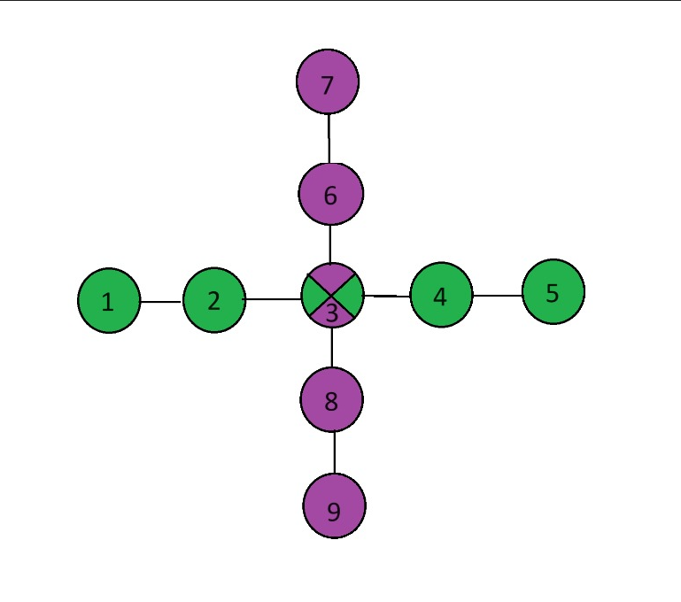
ROUTE IMAGE : Y.
efintan names.

Slide 6
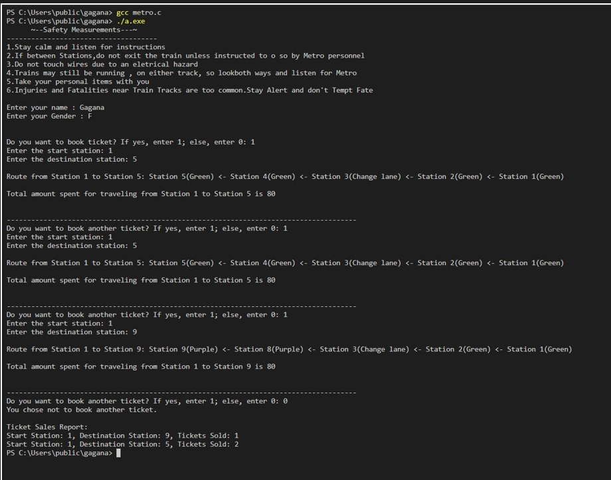
Code Output : Y.
4. Array: For defining the station names.

Slide 7
Contribution of each Team Member
Gauthami S:
Route Planning-> implementing data structures and algorithms for creating different routes, Updates Metro route data, schedules, and station information in the database
Safety Measurements->Assessing and mitigating security risks and vulnerabilities.
Gagana Sindhu P:
Route Planning-> implementing data structures and algorithms for route tracking and navigation, printing the route that must be taken by the user.
User Interface->Designs the user interface (UI) for the Metro route tracker.
G Spandana:
Ticket Information->Designing user-friendly screens and forms for ticket purchase and information display , generating the tickets based on the requirement and using them to generate the ticket sales report .
Data Analytics ->optimizing route data for efficiency.
Durgadeepa P:
Fare Calculations->calculating fare for each station and the total fare for travelling and displaying it.
Ticket Information-> Designing user-friendly screens and forms for ticket purchase and information display , generating the tickets based on the requirement and using them to generate the ticket sales report .

